Slide 1
UNIT 5 Cloud Service Models and Cloud Infrastructure
Presented by
Er.Harendra Bikram Shah
(Lecturer)
Department of Computer Engineering

Slide 2
OUTLINES
Jericho Cloud Cube Model
Infrastructure-as-a-Service
Platform-as-a-Service
Software as-a-Service
Communication-as-a-Service
Database-as-a-Service
Cloud Computing at Amazon
Amazon Web Services
Cloud Computing from the Google Perspective
Window Azure and Online Services
Open Source Software Platforms for Private Clouds.

Slide 3
Jericho Cloud Cube Model
It is a forum of an independent group of international information security leaders
Basically defines the cloud formation dimensions
Objectives of Jericho Forum:
The Jericho forum points out that in clouds not everything is best implemented that is something should be implemented in offline mode.
identified different cloud formations.
describes benefits, key characteristics, and risks of each cloud formation
Provide a framework for seeking in more detail the nature of different cloud formations and the issues that demands to answer to make secure places to work in and make them safe.
Points to be remember before setting up the security in cloud
Step 1
The classification of the data, the customer should know what rules must be applied to protect it.
Step 2
It should be ensured, the data exist only in specific trust levels.
Step 3
It should check that what regulatory compliance and restrictions are applicable. For example, the data should stay in a particular boundary and whether it has to stay in the safe harbour or not.

Slide 4
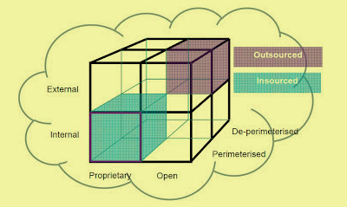
Jericho Cloud Cube Model

Slide 5
Questions For Cloud Cube Model
The Jericho forum states that there are three key questions, which a customer should ask their Cloud Computing supplier. So, that they must be aware that the data is secure and protected.
The three questions are-
Q 1. Wherein the cloud cube model is the cloud supplier operating while providing the services?
Q 2. How will the clouds suppliers get a surety when the customer is using services in a cloud from that has maintained the features as per the expectations?
Q 3. How can a customer ensure that the data which is stored in the cloud services will be available at the time of mis happenings such as bankruptcy or change in business direction?

Slide 6
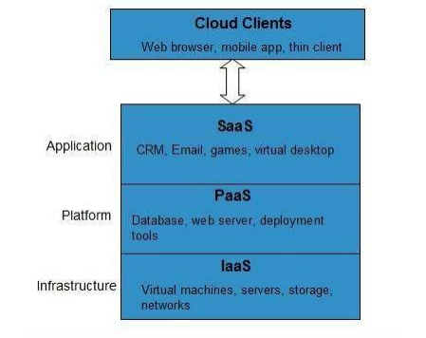
Cloud Models based on Service

Slide 7
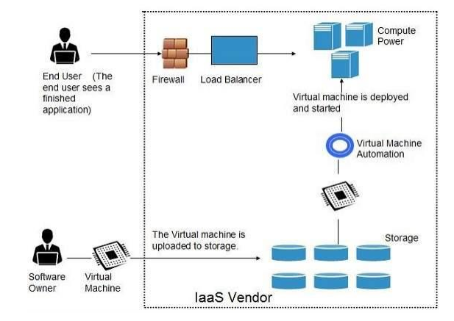
IAAS

Slide 8
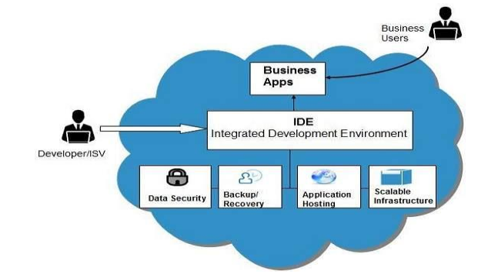
PAAS

Slide 9
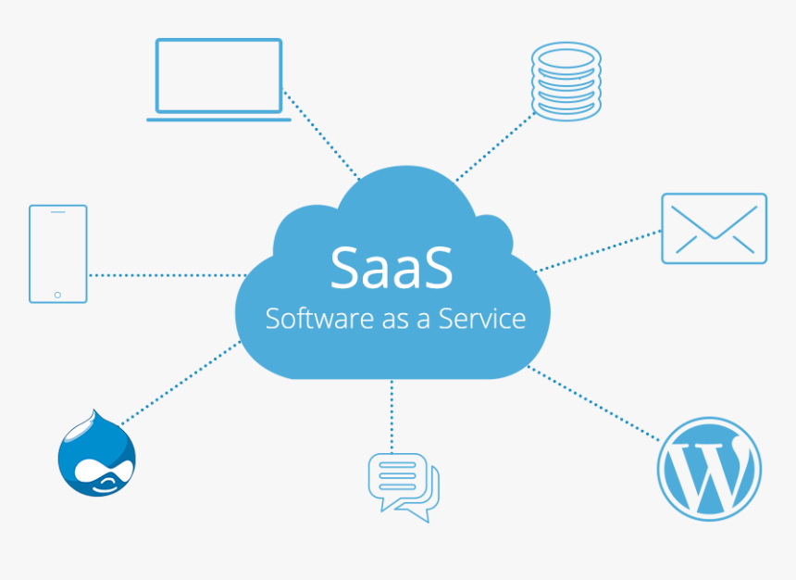
SAAS

Slide 10
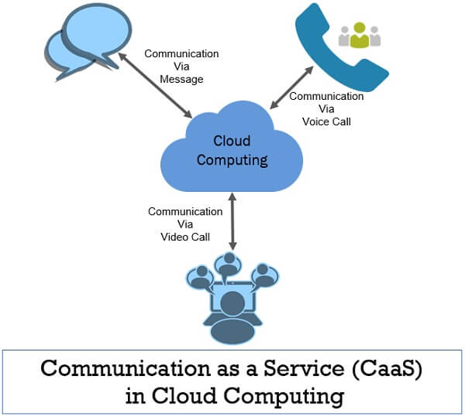

Slide 11
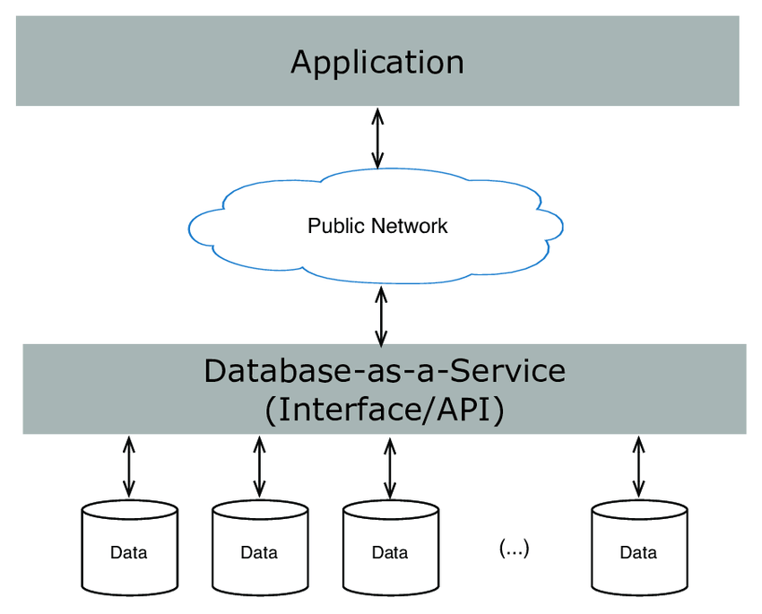

Slide 12
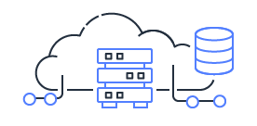
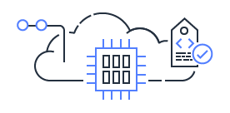




Cloud Computing at Amazon
SAAS
IAAS
PAAS
Cloud Computing Services at Amazon
Cloud
Hybrid
On-Premises
Cloud Computing Deployment model at Amazon

Slide 13
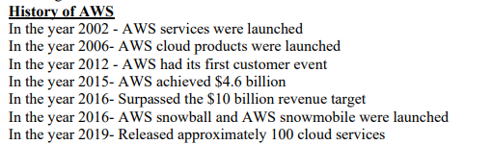
Applications of AWS
Gaming
Storage and Backup
Websites
Mobile web and social applications

Slide 14
Amazon Web Services
Compute
Storage
Databases
Networking
developer tools
management tools
IoT
Security
Gaming's
Enterprise applications
List of companies using AWS:
Netflix
Intuit
Coinbase
Finra
Johnson & Johnson
Capital One
Adobe
Airbnb
AOL
Hitachi
Benefits of AWS
Flexibility and Scalability
Security
Little Investment
Available globally

Slide 15
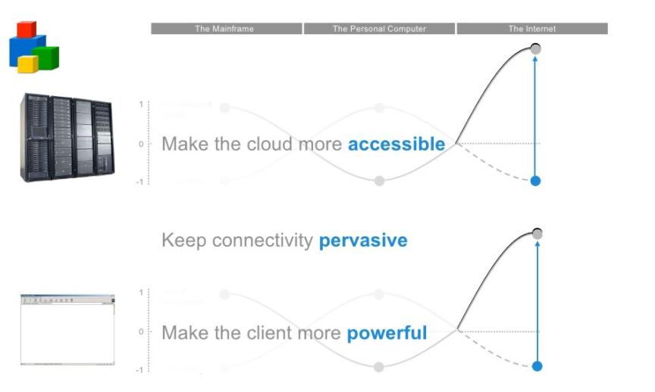
Cloud Computing from the Google Perspective

Slide 16
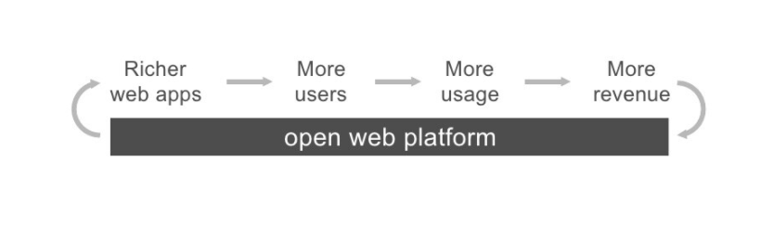

Slide 17
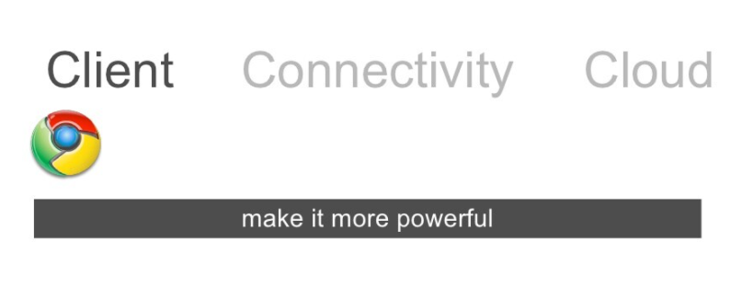

Slide 18
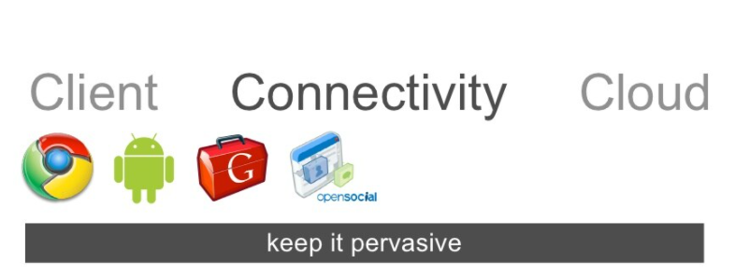

Slide 19
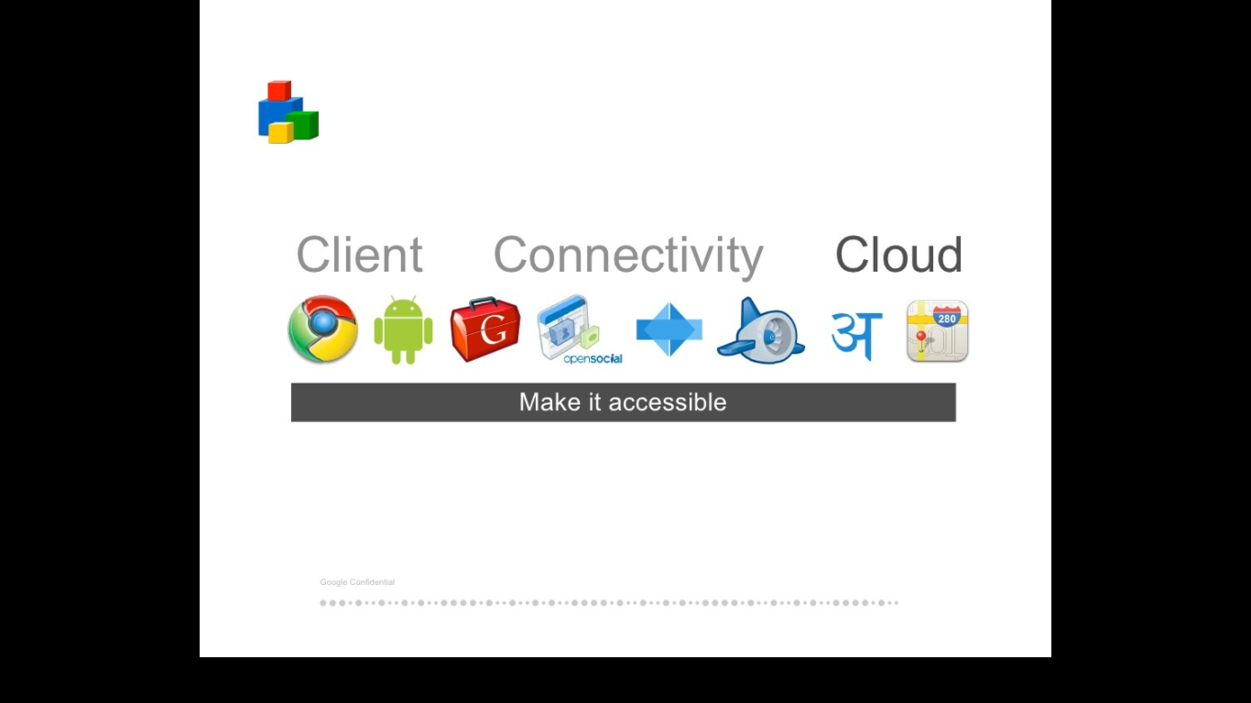

Slide 20
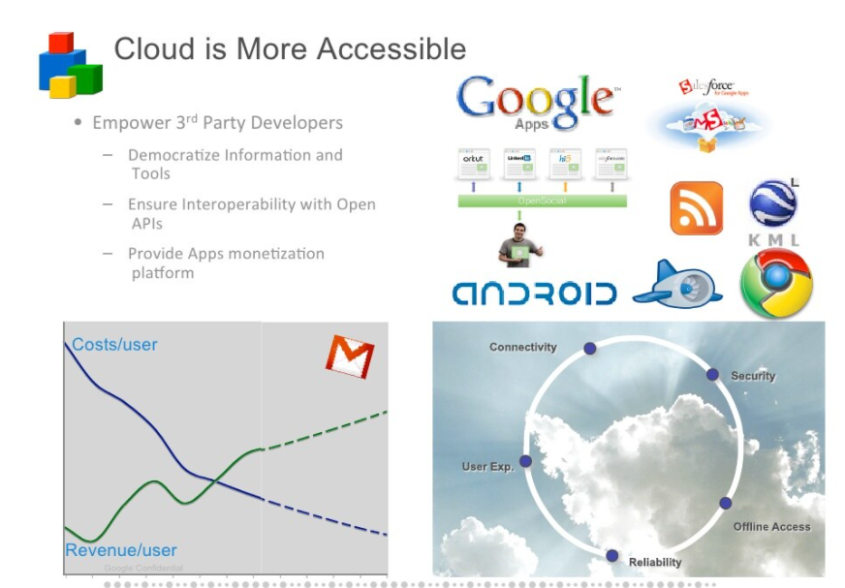

Slide 21
Window Azure and Online Services
The Azure cloud platform is more than 200 products
600 cloud services designed to help you bring new solutions to life—to solve today’s challenges and create the future.
Build, run, and manage applications across multiple clouds, on-premises, and at the edge, with the tools and frameworks of your choice.
Top 10 services by Azure
Virtual Machines.
Azure DevOps.
Azure Cosmos DB.
Azure Active Directory.
API management.
Azure Backup.
Azure Content Delivery Network.
Logic Apps.

Slide 22
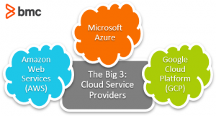

Slide 23
Azure customers include:
DAIMLER AG
McKesson Group
Asos
Center of Disease Control (CDC) – US
National Health Service (NHS) – UK
HSBC
Starbucks
Walgreens
3M
HP
Mitsubishi Electric
Renault
AWS customers include:
Expedia
Netflix
Coinbase
Formula 1
Coca Cola
Intuit
Airbnb
Lyft
Coursera
Food and Drug Administration (FDA)
GCP customers include:
Toyota
Unilever
Nintendo
Spotify
The Home Depot
Target
Twitter
Paypal
UPS
Top 5 Cloud Providers in 2022
Amazon Web Service (AWS)
Google Cloud Platform.
Microsoft Azure.
IBM Cloud.
Oracle.

Slide 24
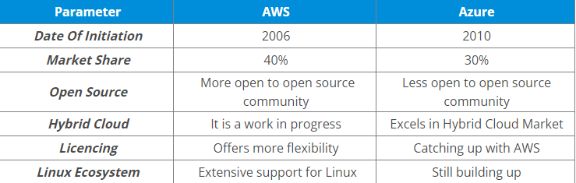

Slide 25
Open Source Software Platforms for Private Clouds
Cloud Foundry
WSO2
Cloudify
OpenShift
Tsuru
Stackato
Alibaba

Slide 26
END of the UNIT

